Slide 1




ROS - POWER BI
PROJECT PRESENTATION

Slide 2

PROJECT INTRODUCTION
ROS – Restaurant One Solution
ROS is a software designed to boost a restaurant’s productivity.
unlock profit by eliminating errors and automating fresh operational processes.
Accounting, cash management, personnel management, inventory management, or delivery services reconciliations.

Slide 3
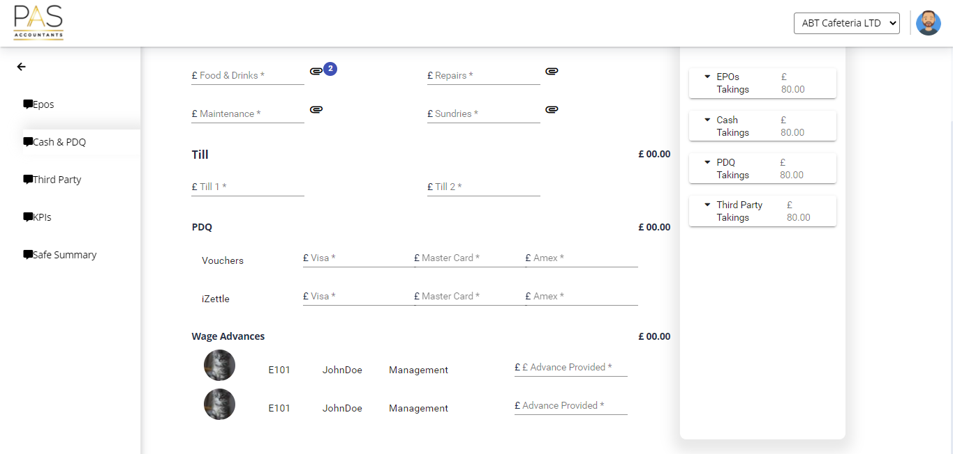
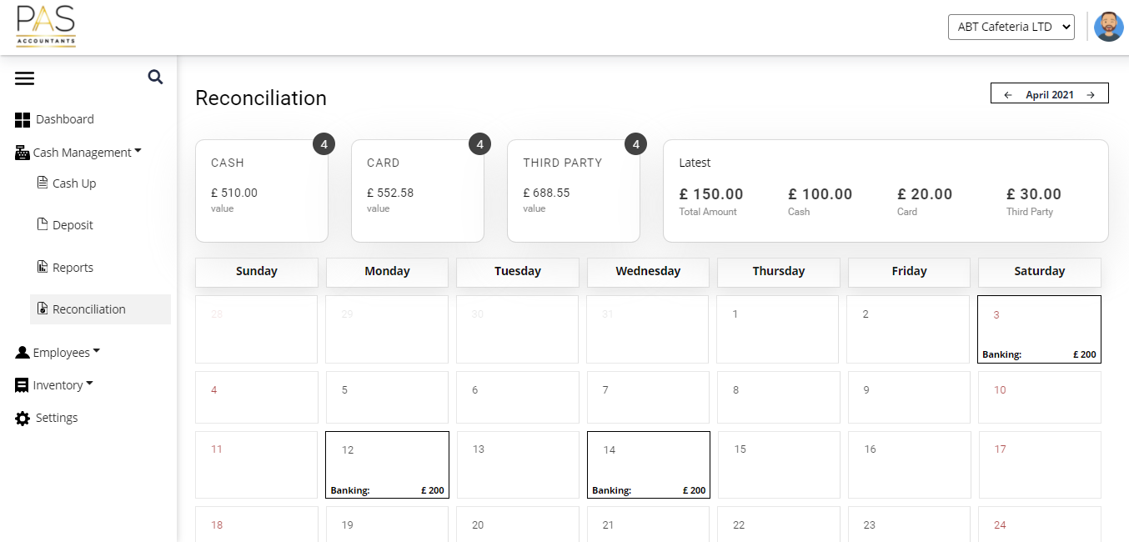
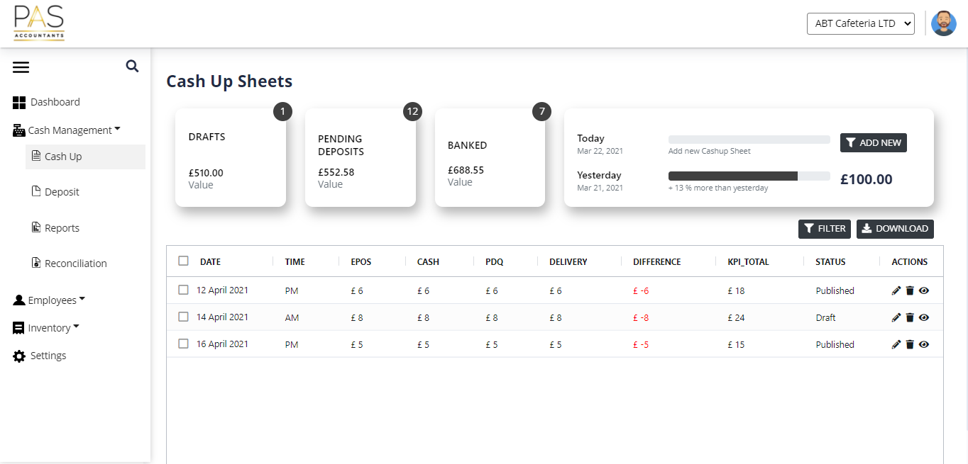
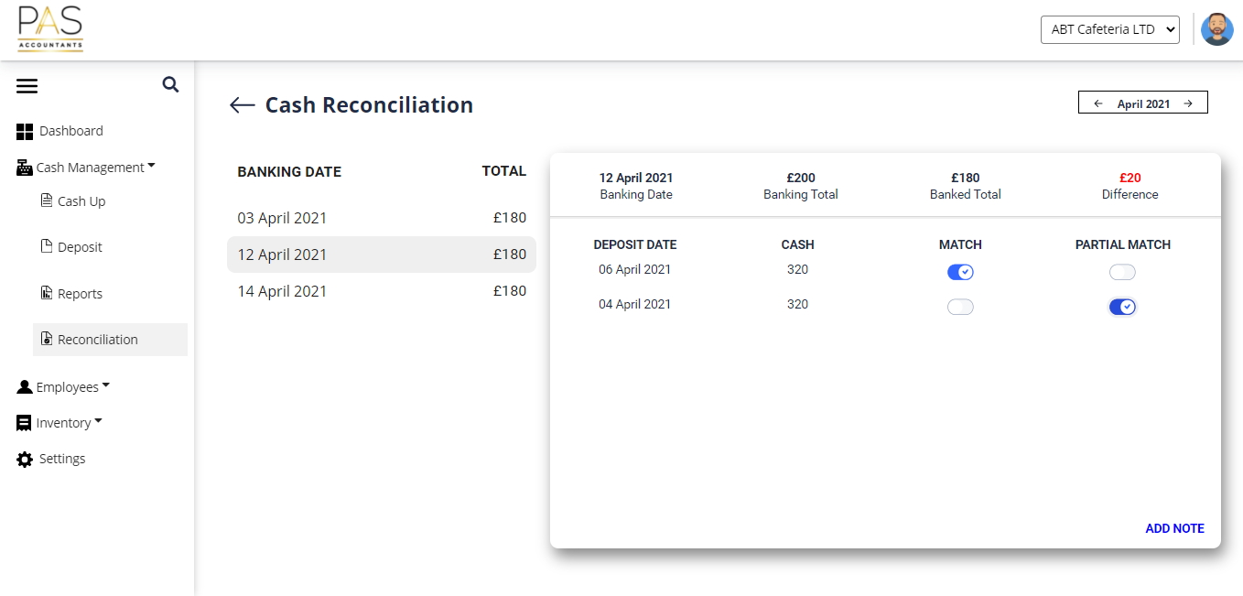
BUSINESS MODULES
ACCOUNTING
HR
INVENTORY
FORECASTING
ADMINISTRATION
REPORTS AND DASHBOARDS
APP VIEW

Slide 4

AGENDA
Goals
Project Requirements
Business Modules
Delivery in Numbers
Project Requirements
Tech Stack
Key Highlights
Data Sets
Data Anomalies
Data Dictionary
DB Design
Data Generation Techniques
Visualizations
Demo
Q n A

Slide 5

GOALS
MIGRATE 100% DATA SUCCESFULLY
100% ACCURACY IN MIGRATION
ENABLE HIGH QUALITY BUSINESS INTELLIGENCE
EXCEL REPORTS

Slide 6
DELIVERY LANDSCAPE
DATA SET
DATA DICTIONARY
DATA ANOMALIES
DATA COLLECTION
DATA GENERATION
DATA CONNECTIONS
DATA INSIGHTS

Slide 7
PROJECT REQUIREMENTS
DATA SETS
Clients
Accounts
RestaurantsAddresses
Currencies
Departments
Roles
Countries
Business Module
Functional Module
Features
Subscription
Product
Restaurants
14. Cash up
15. Sales
16. Tax info
17. Third party info master
18. Petty cash
19. Banking info
20. Cashnpdq

Slide 8
DELIVERY IN NUMBERS
20
XX
XX
XX
20
133
DATA ENTITIES
DATA SETS
DATA FIELDS
XX
XX
XX
20
7
6
TABLES
VISUALIZATIONS
TECHNIQUES

Slide 9



TECHNOLOGY STACK

Slide 10
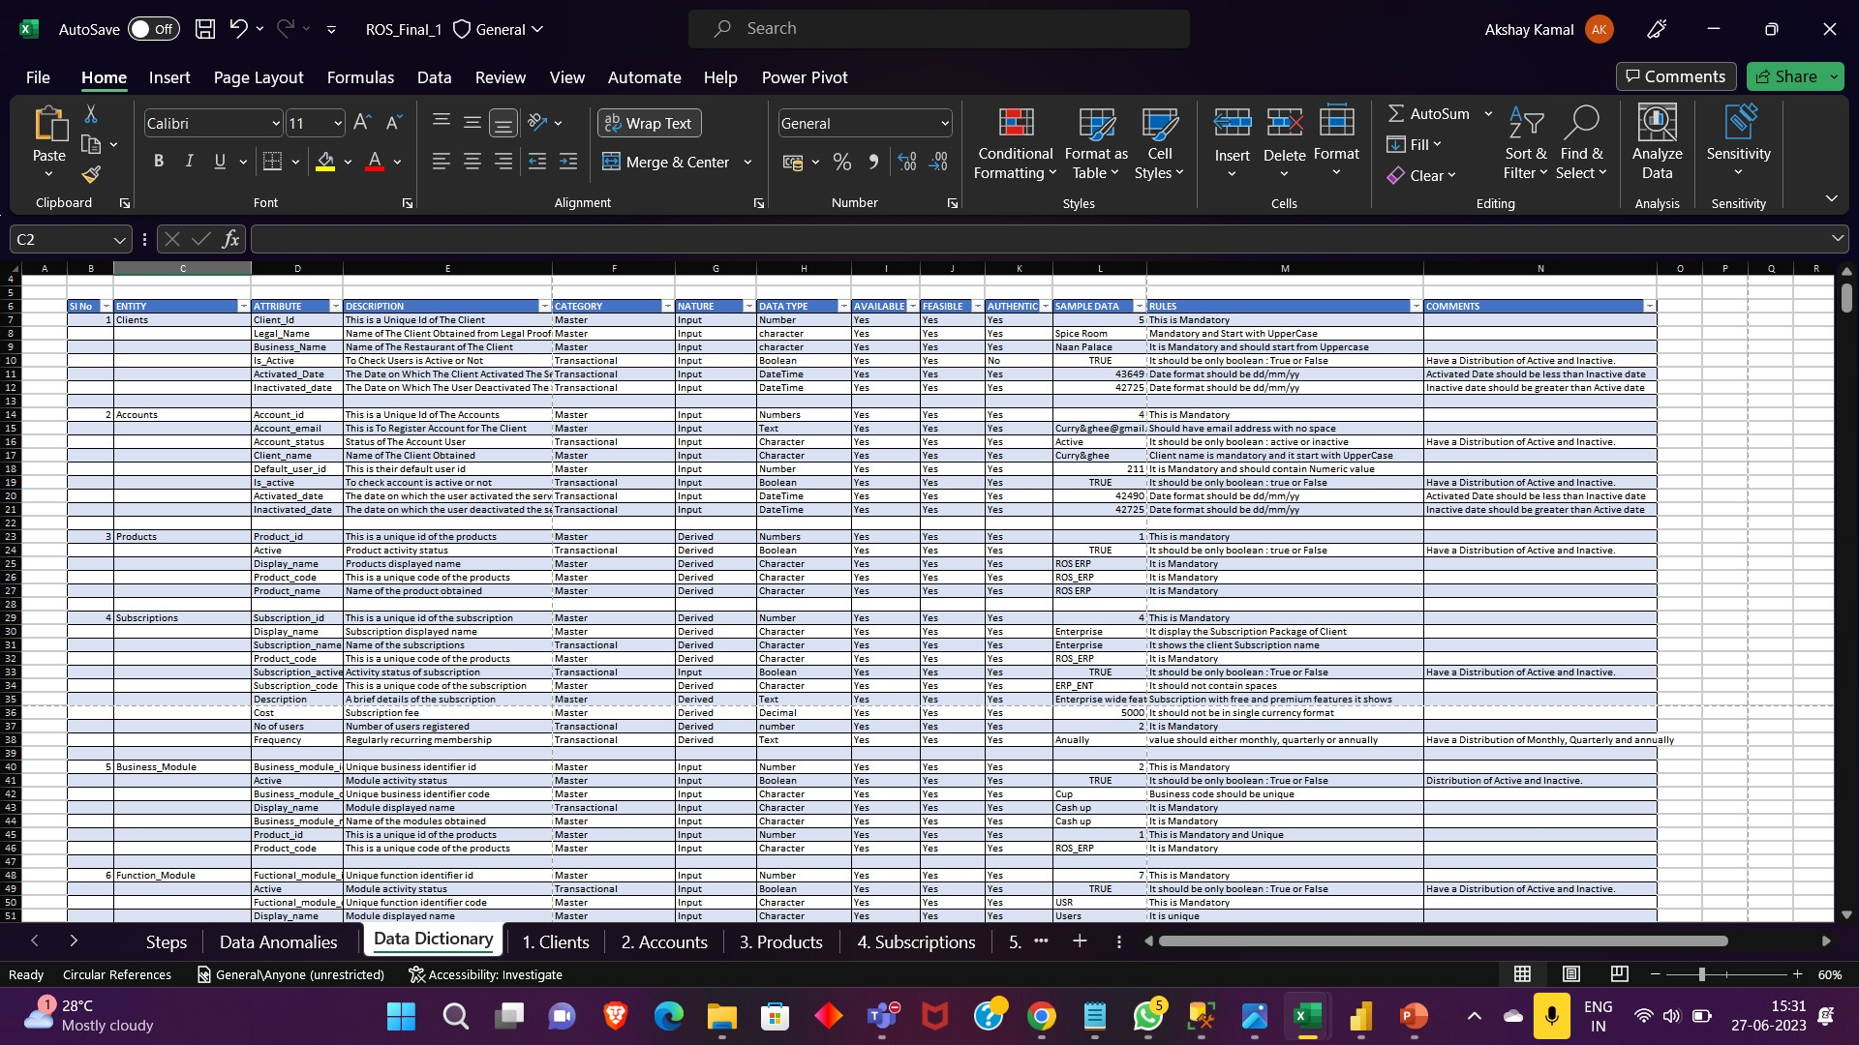
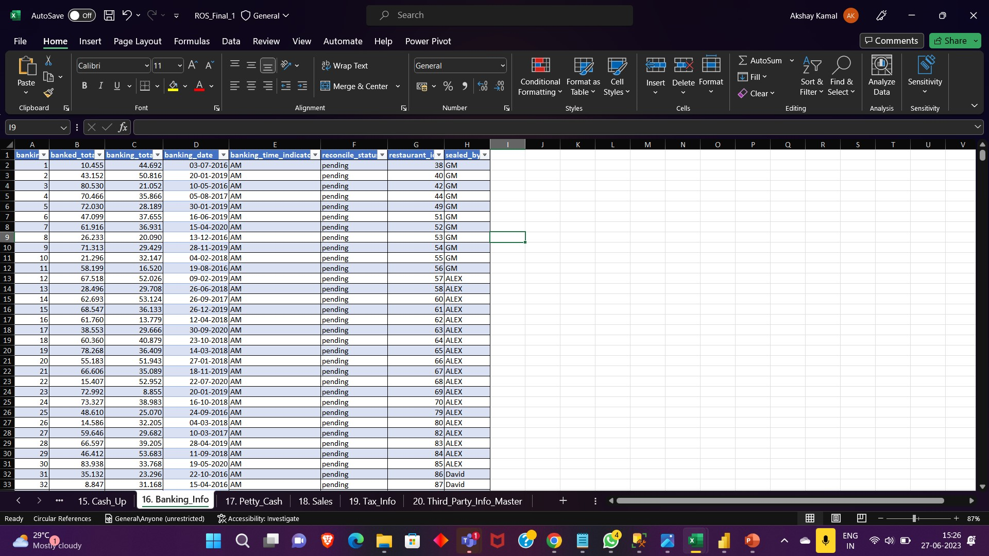
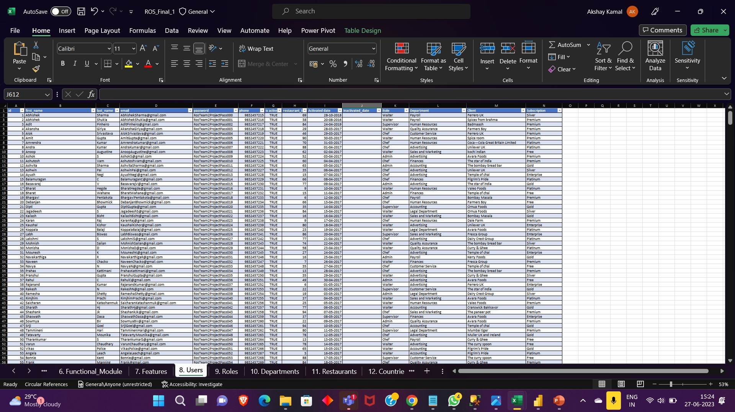
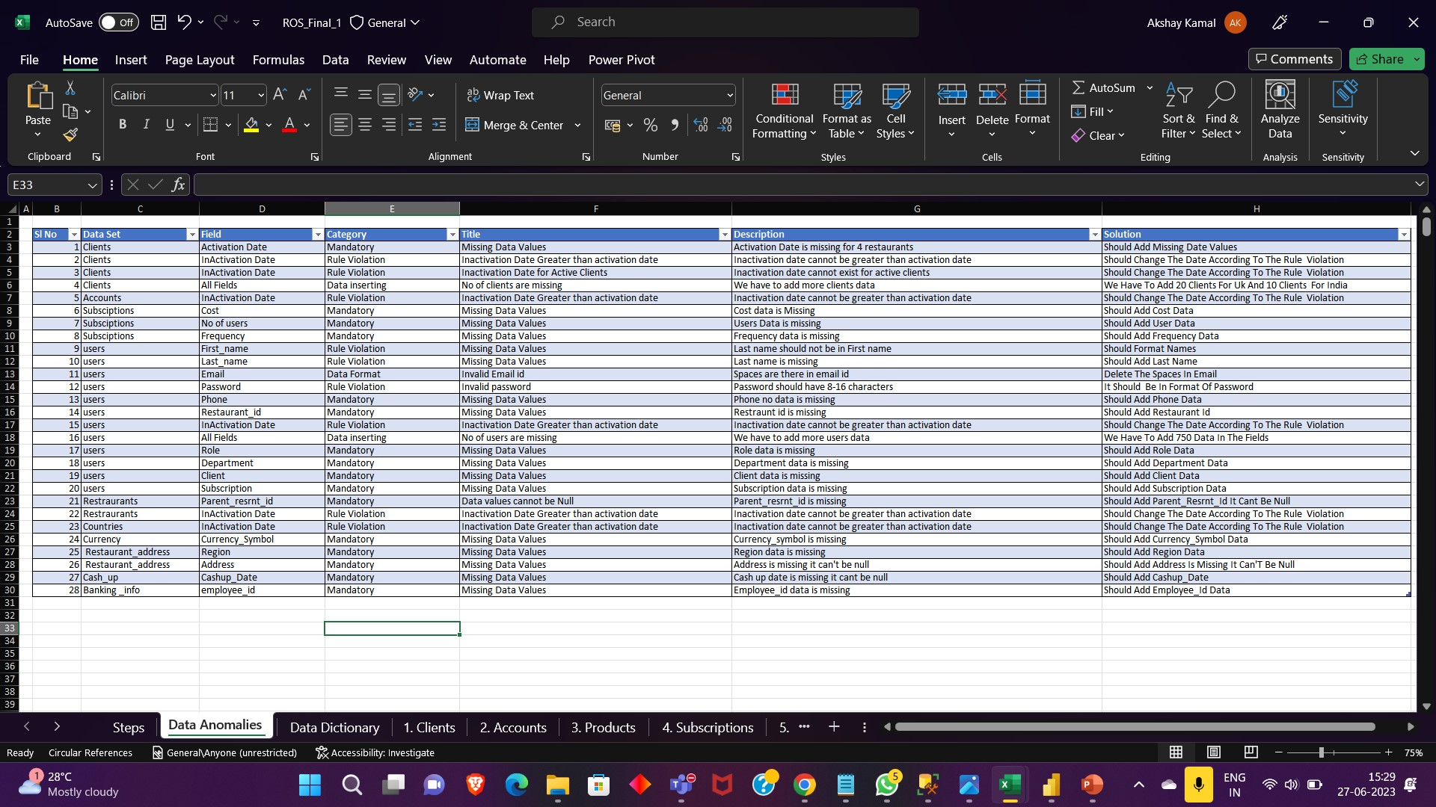
DATA SETS
XX
20
DATA SETS

Slide 11
DATA DICTIONARY

Slide 12
DATA ANOMALIES

Slide 13
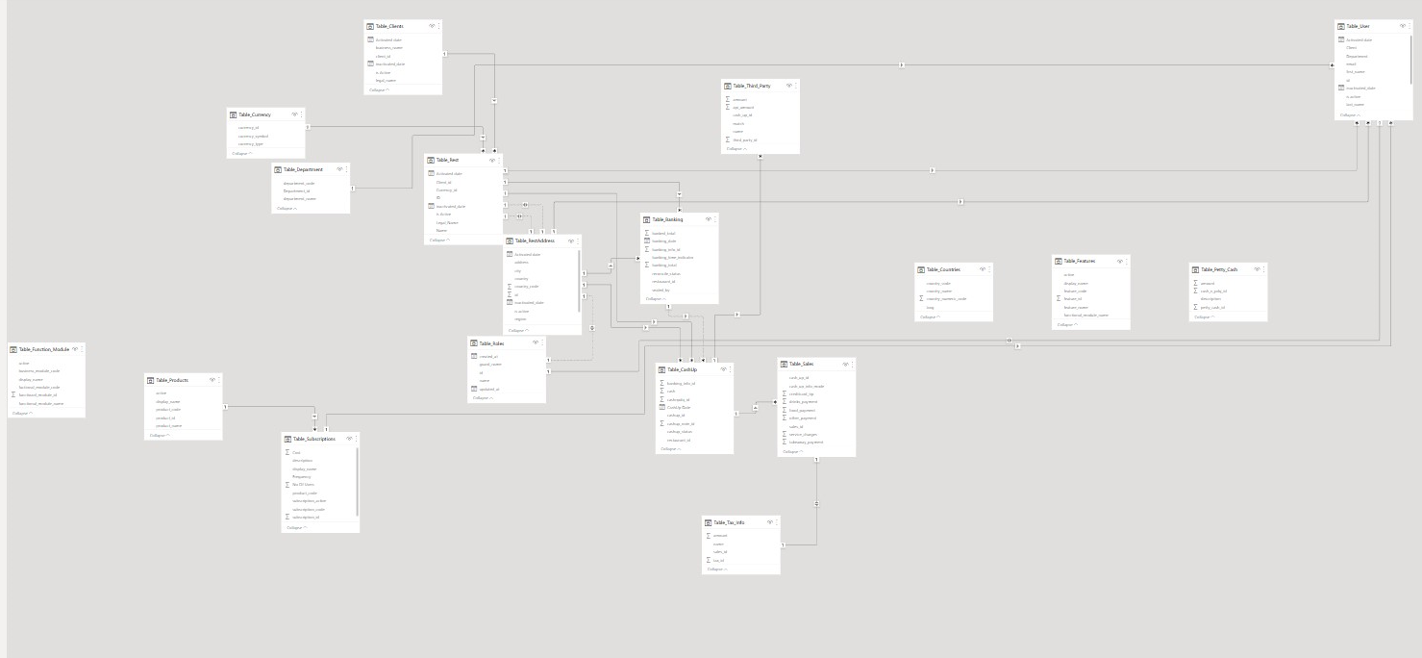
DATABASE DESIGN

Slide 14


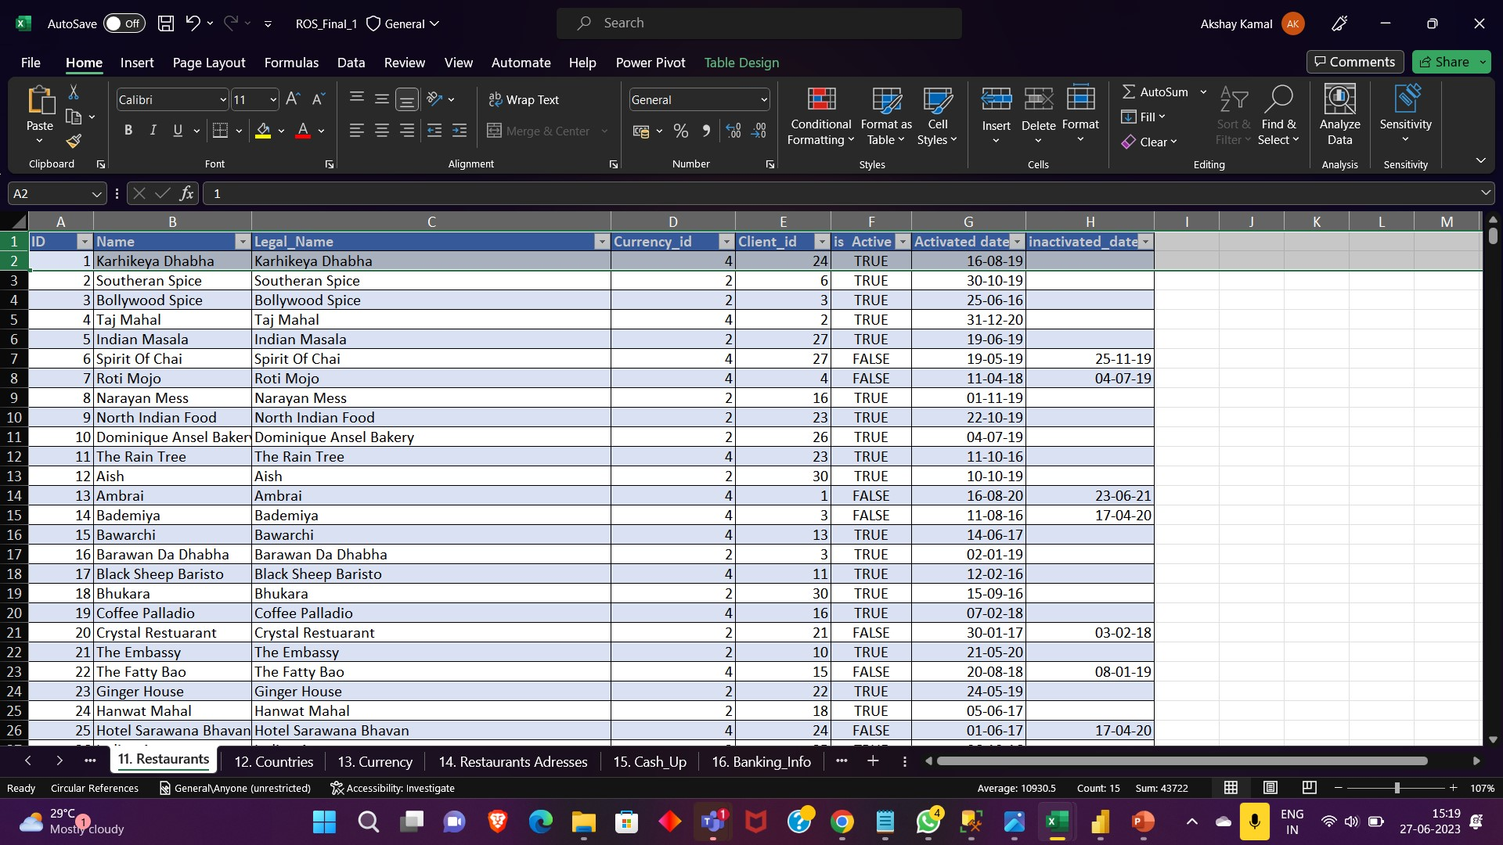
DATA GENERATION
TECHNIQUES
RANDBETWEEN
CHOOSE
RAND
PROPER
GOOGLE
REPLACE
XX
150
RESTAURANTS
XX
750
USERS
XX
100000
CASHUPS
XX
118
BANKING

Slide 15


ANALYTICS FOR ROS
XX
20
ENTITIES
7
VISUALIZATIONS

Slide 16

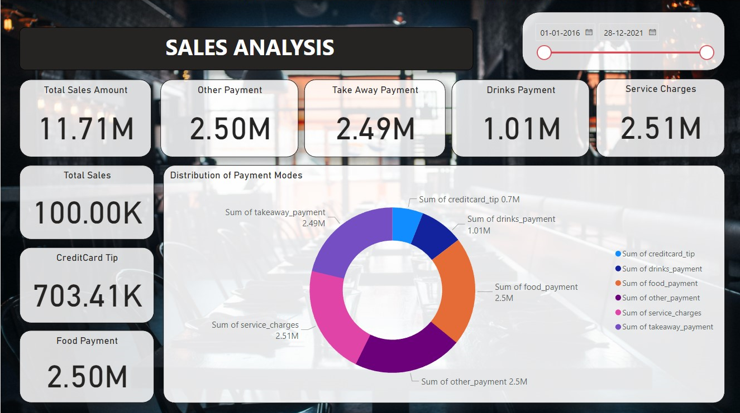

Slide 17
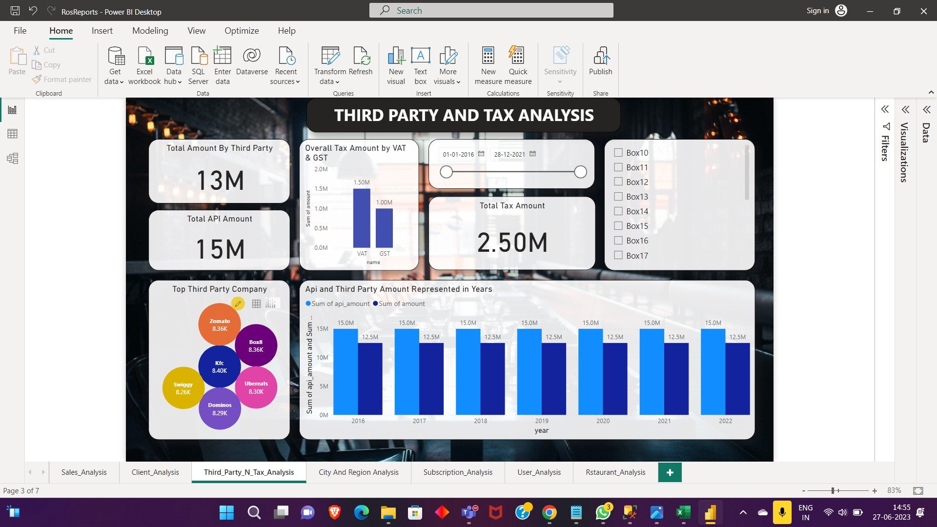
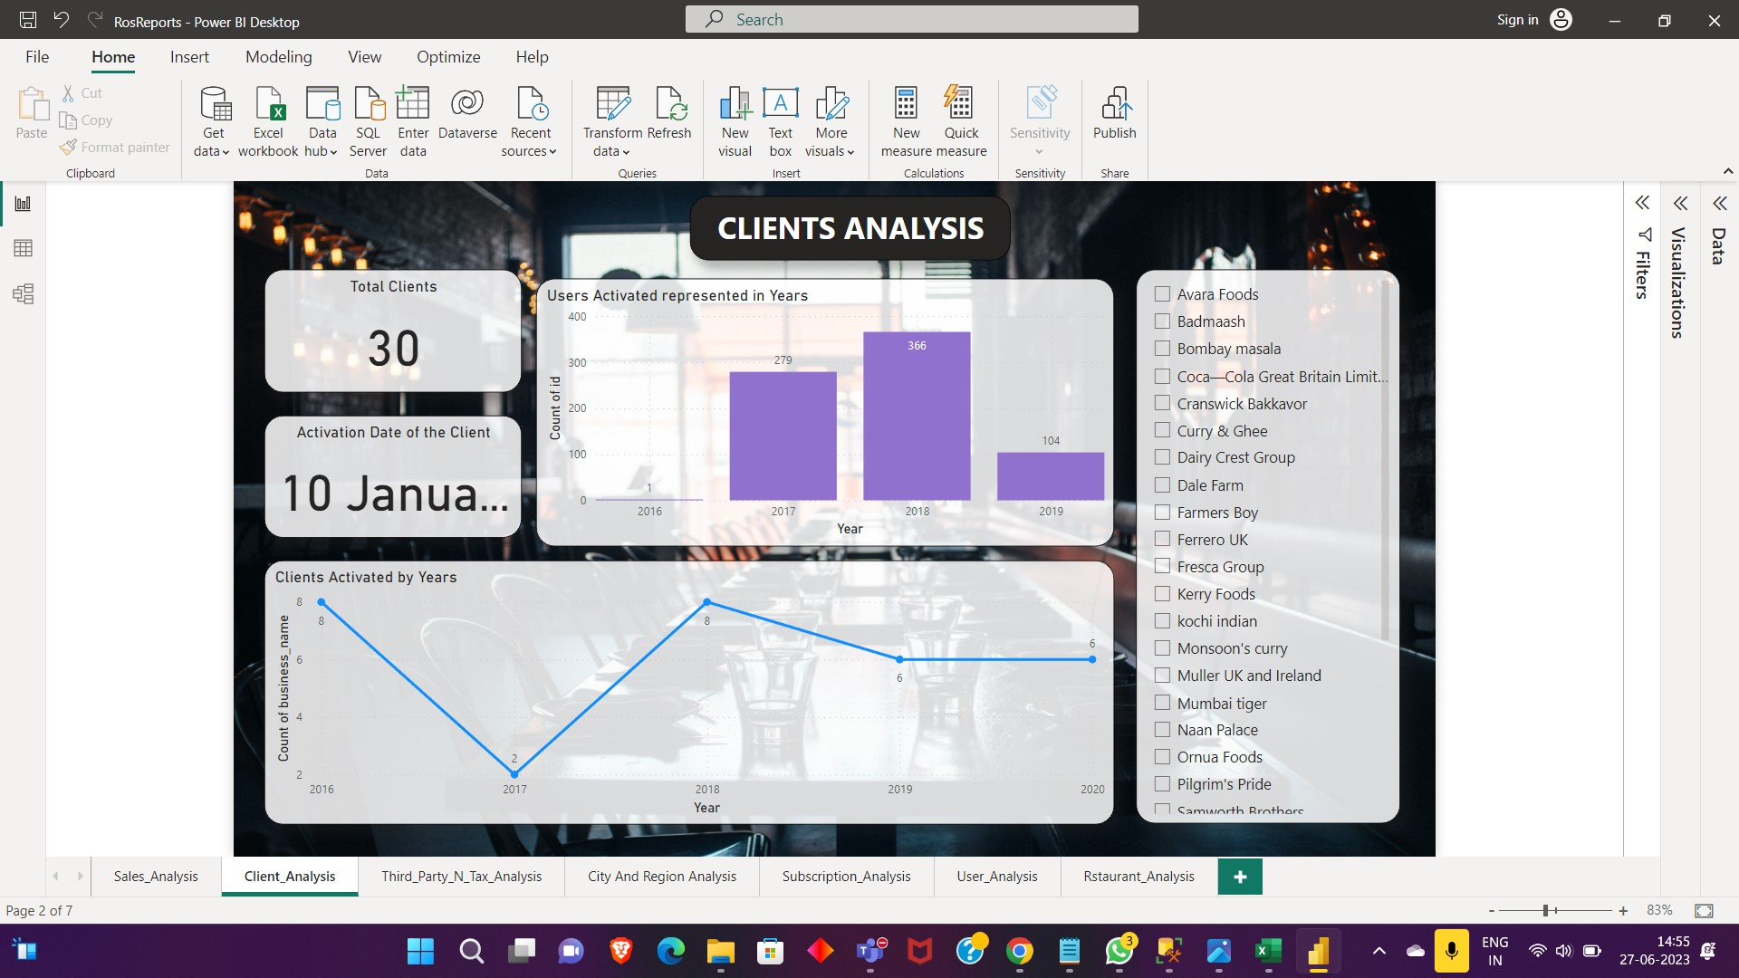

Slide 18
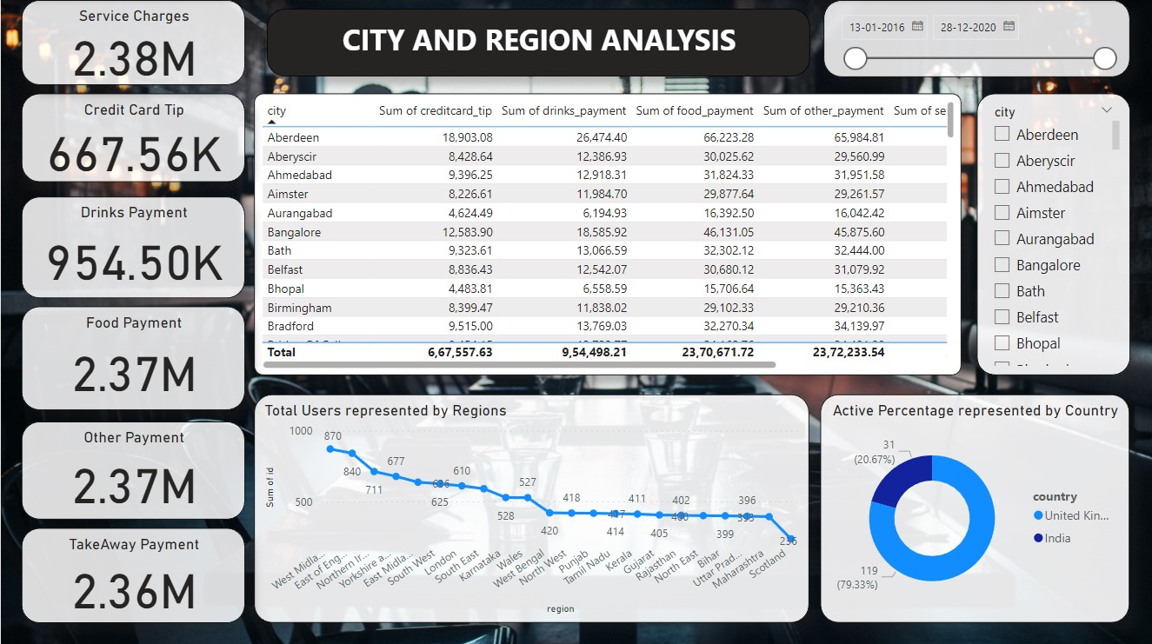

Slide 19
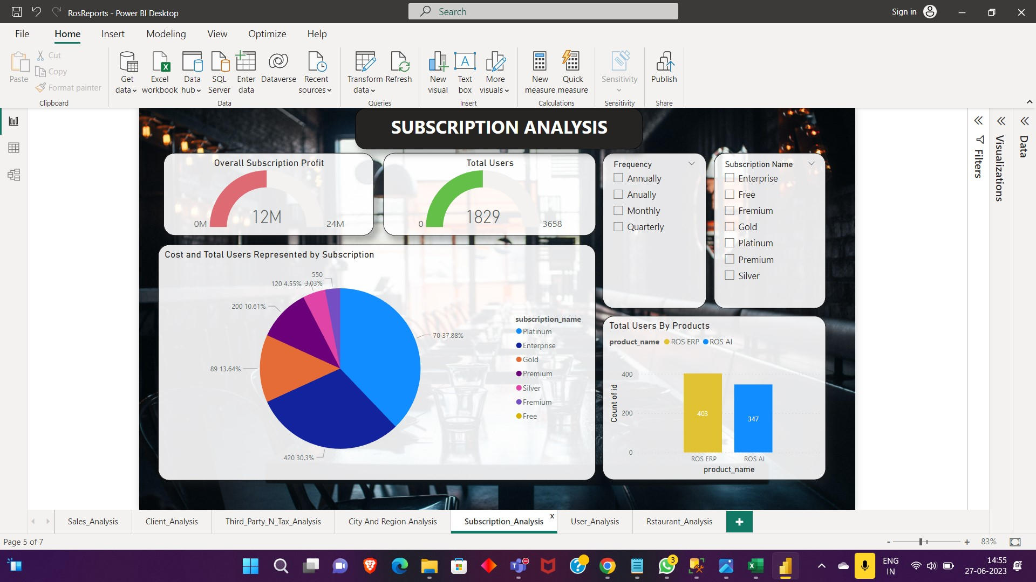
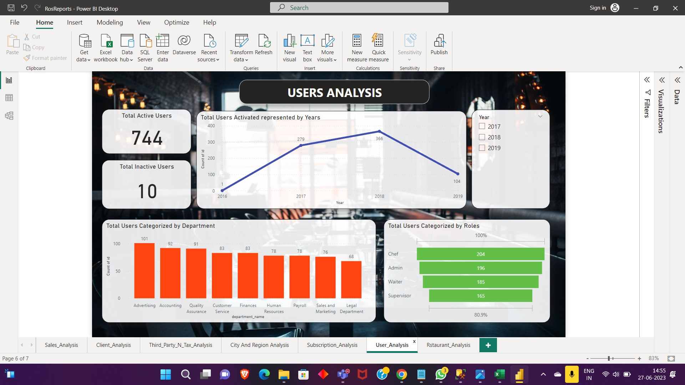

Slide 20
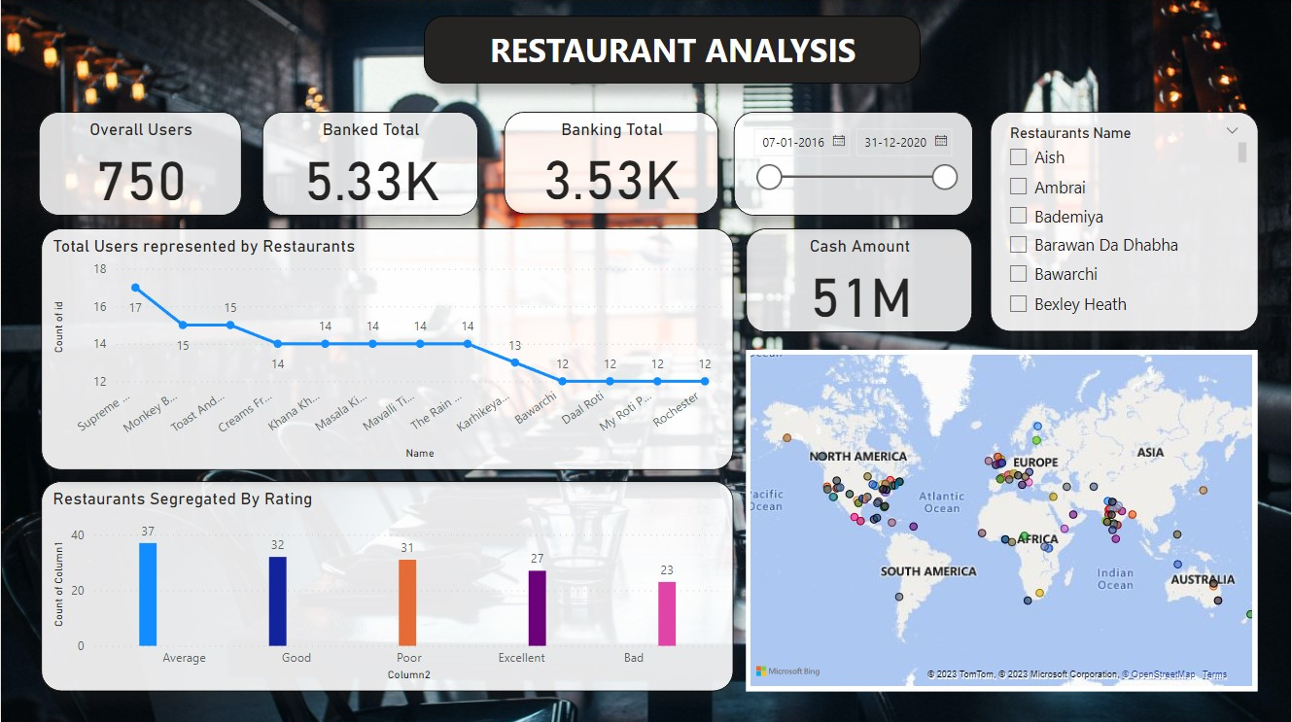

Slide 21
OUR TEAM
Akshay Kamal V
Chadaram Dinesh
Shreyansh Shourya
Katikala Vamsi

Slide 22
OUR EXPERIENCE

Slide 23

Thank You
© Pratian Technologies (India) Pvt. Ltd, 2020

